Slide 1
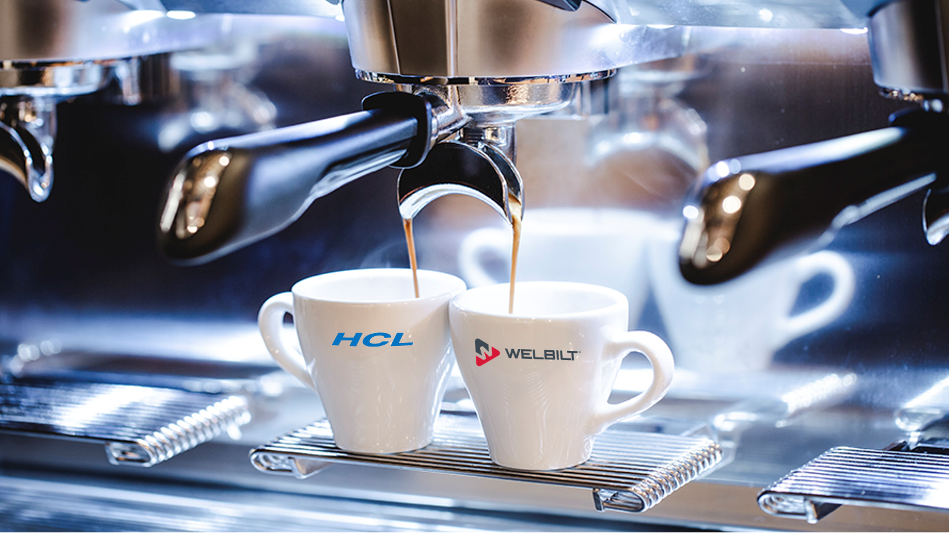
STRATEGIC PARTNERSHIP

Slide 2
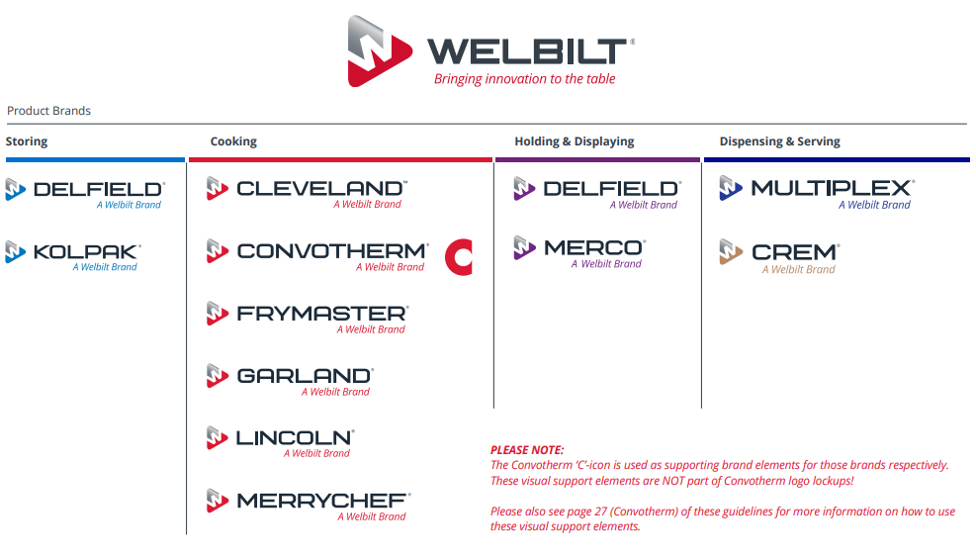
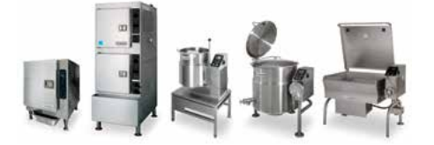
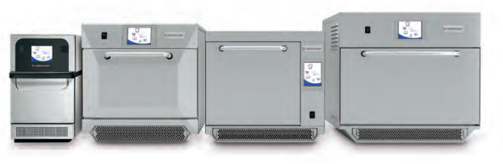
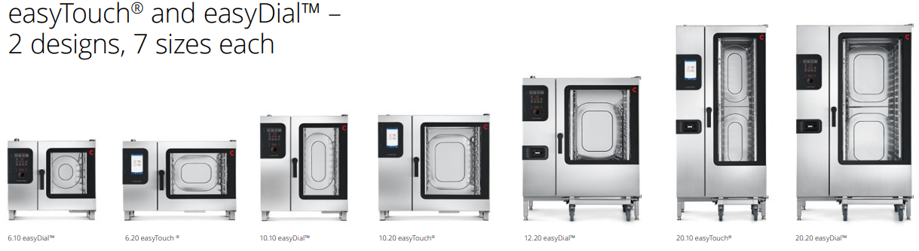
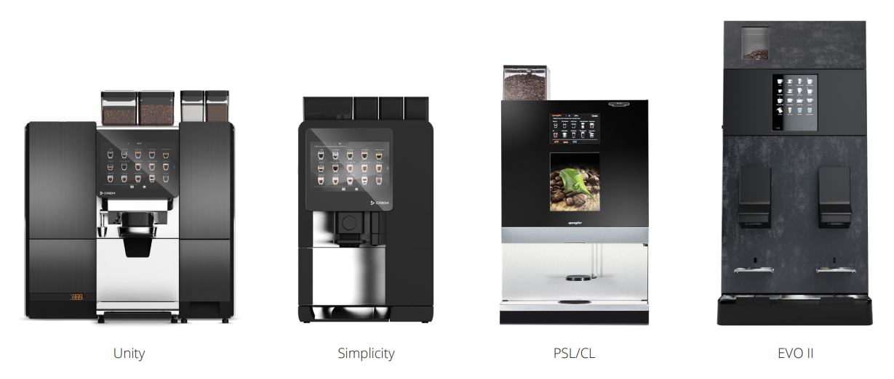
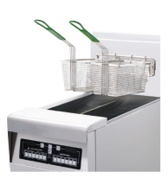

Slide 3
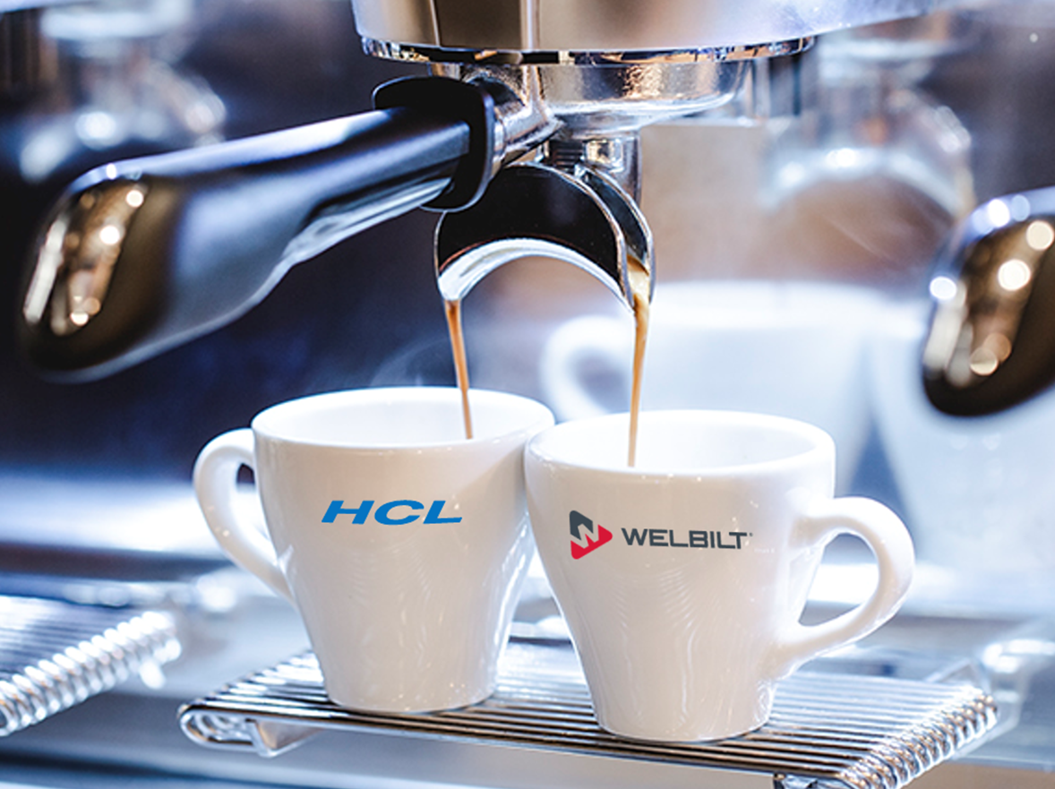
Connected Kitchen
KitchenConnect is our award-winning open cloud solution for the food-service industry that improves efficiency, reduces costs, and enhances food quality.
It offers an overview of the products cooked, peak demand hours, product utilization, and cleaning cycles.
It allows cost savings through over-the-air recipe pushes and predictive maintenance ensuring less downtime while maintaining food quality through online food safety report retrieval.

Slide 4

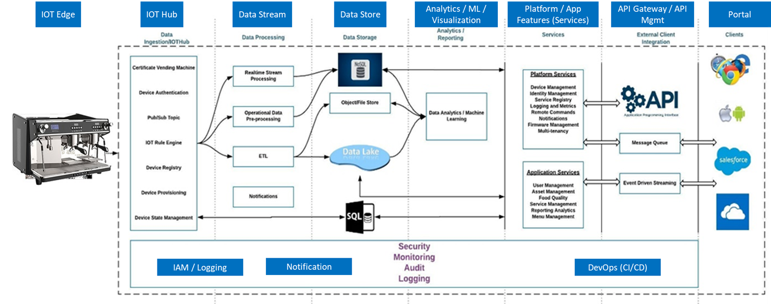
KC Application – Flow Diagram
Salient Features:
Device Connectivity
Asset Management
Authentication & Authorization
Service Management
Telemetry & Device Data Processing
Food Integrity & Quality
Data Storage
OTA-Firmware/Menu/Media update
Alerts & Notifications
User Management
Reporting and Analytics
Report Management
Cloud based SaaS
Multi-Tenant
GDPR Complaint
Progressive Web App & API Enabled
Function based micro services
12 brands with 20+ types of equipment
2 Million+ external API calls
Multi-geo deployment US, Europe and Asia
Volume of Messages - 100,000 packets per hr.
Technology Stack
Scale

Slide 5

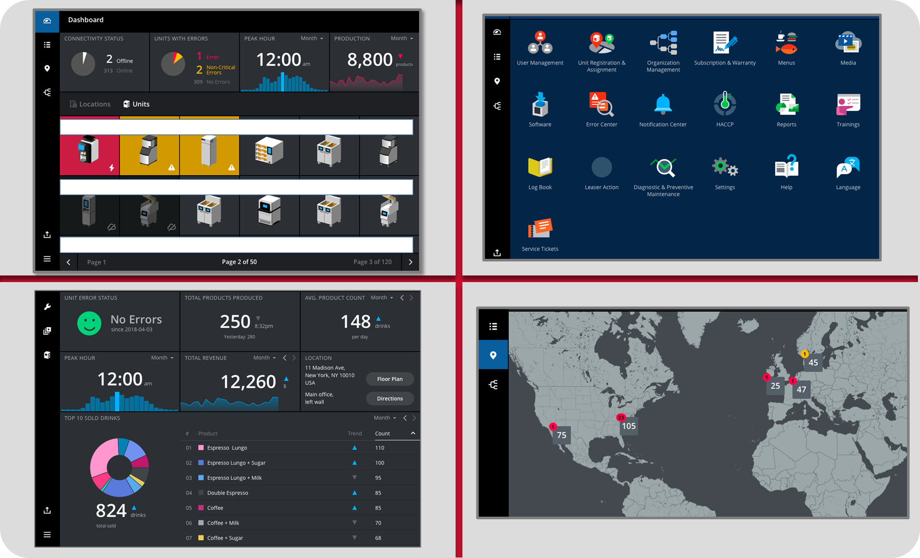

Slide 6

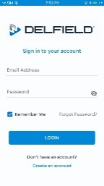
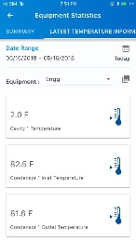
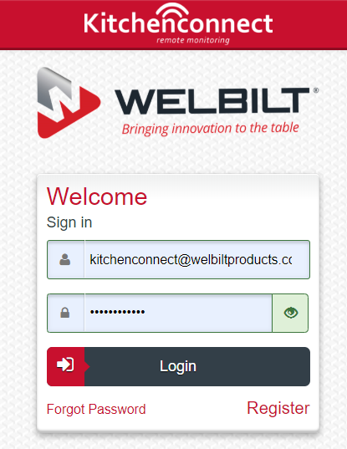
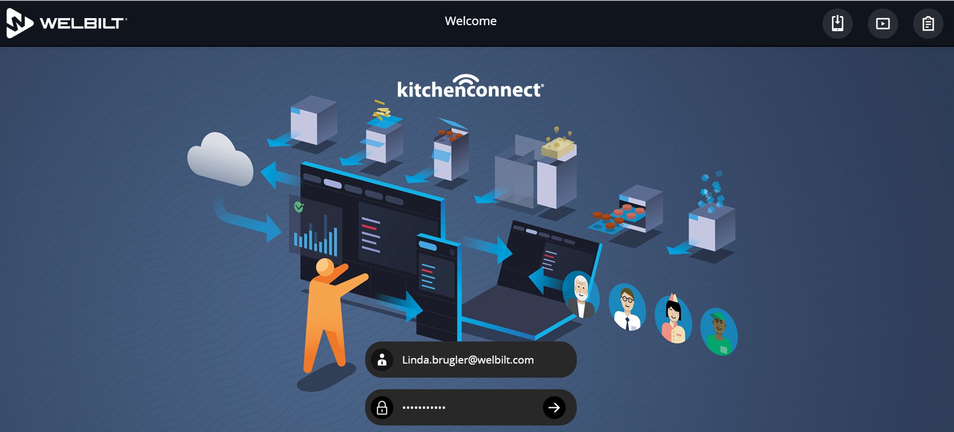
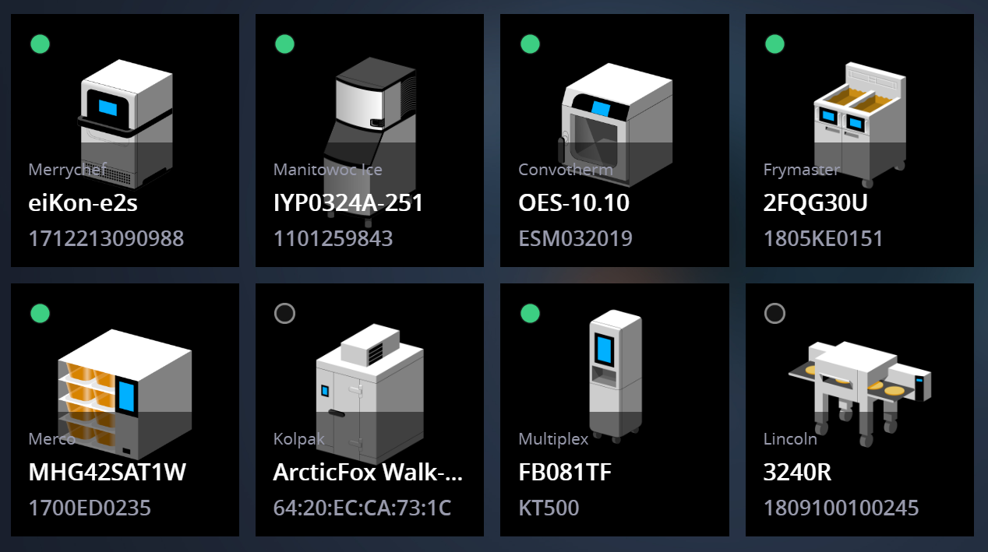





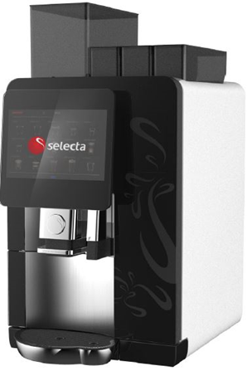
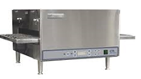
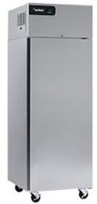
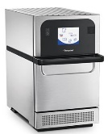
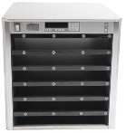
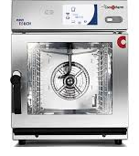
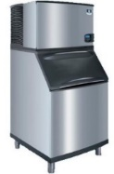
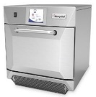
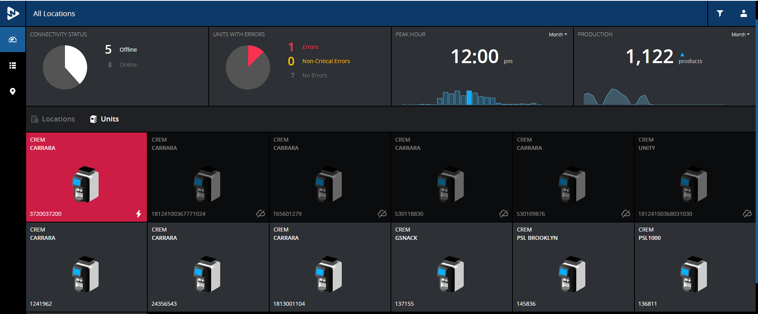
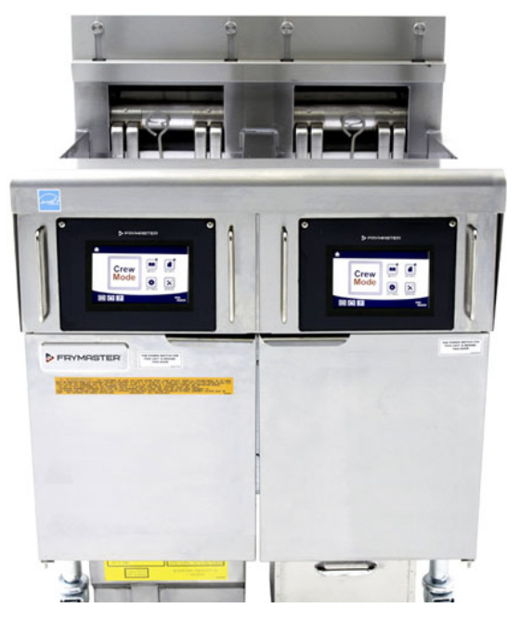
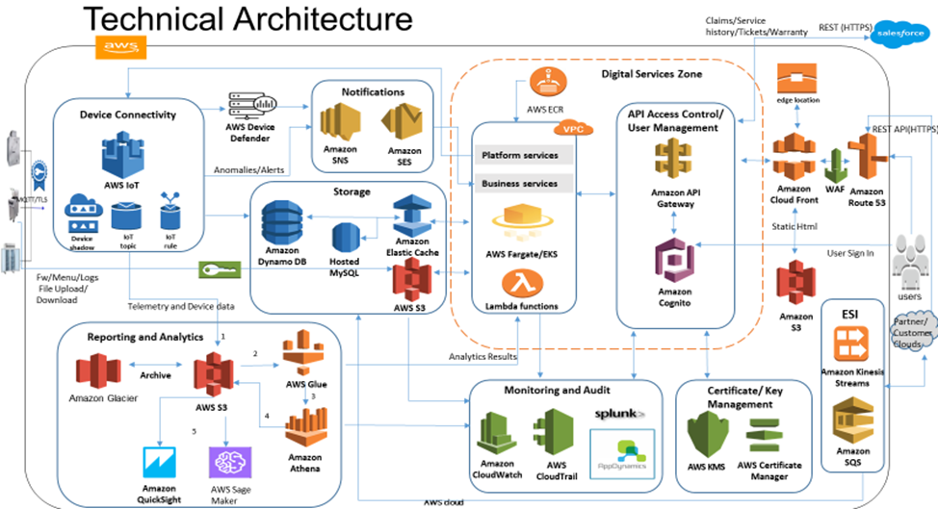
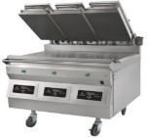
Welbilt - HCL Kitchen Connect Journey Since 2015
Mobile Application
NRA Show Web Application
Embedded & Web Development
Embedded Software
AWS Cloud Platform Development
Platform Development Approach for all the brands to fulfill various customer needs with single solution
550+ connected equipment’s deployed in the Field across 17 Customers
9 Brands Connected Across Globe.
HCL selected as primary partner for engineering services for (embedded software and Cloud based connectivity software solutions.)
40
2019
Embedded Software Testing & Development with Translator Board Developed by Emerson – Control Products.
Connected Fryer, Ice Machine & Garland Grill in McD Austria using Emerson - Site Supervisor.
Embedded Software development - KCCM Board.
Connected 20 Merry chef Oven E2S for Speedway in USA using KCCM & PC Based application with Menu Push Feature
IoT Solution enabled Kitchen Connect Demonstration at NRA show for three brands Merrychef Oven, Indigo Ice and Garland Grill.
KCCM – IoT integrated with Delfield, Merco & Convotherm brands.
100+ connected equipment’s deployed in the Field across United States.
1
5
2016
2018
2017
15
2015
8
Huge Success with 9 brands connected with IoT Solution enabled Kitchen Connect Demonstration at NRA in 2018.
Mobile – Android + IOS Application Development for Defiled Brand.
150+ After Market Field Support
Platform Designed and Reviewed by AWS
IoT Platform based Application Development
Embedded Software
Mobile App
Web Application
Connectivity Software
Aws Platform Development
Team Size

Slide 7
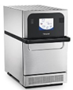
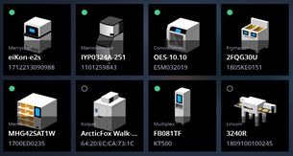
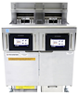
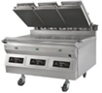



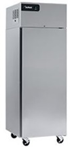
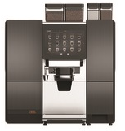
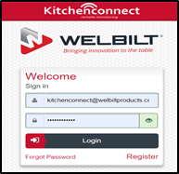
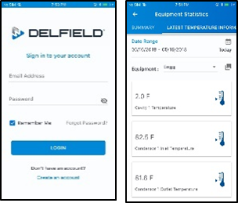
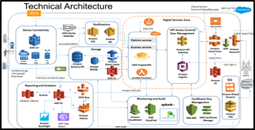
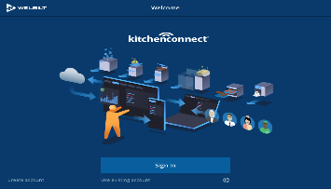
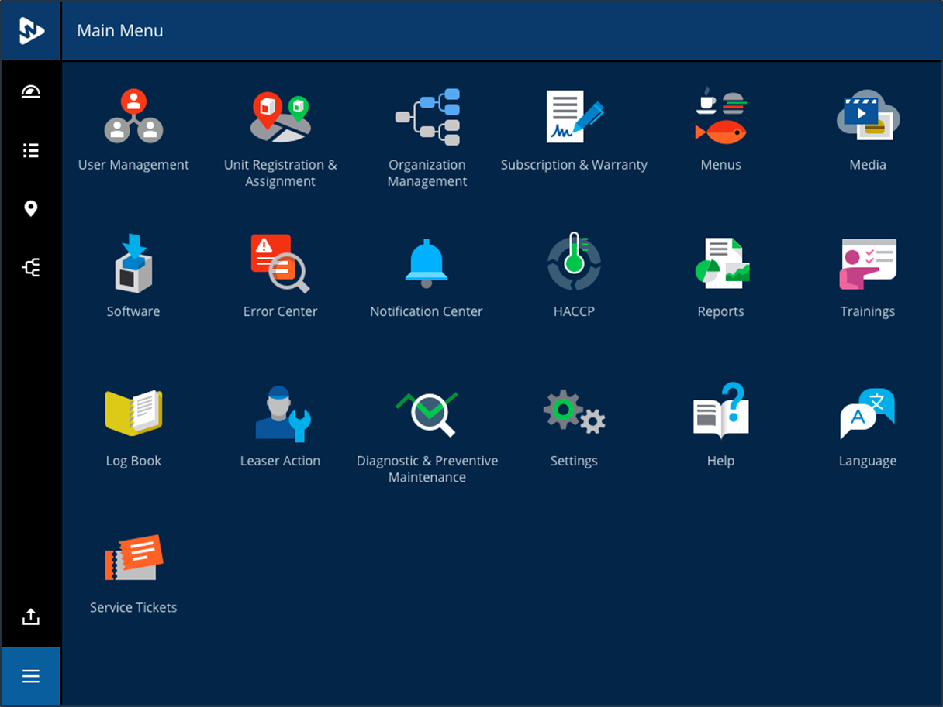

Welbilt - HCL Kitchen Connect Engagement Overview
2015
- Primary partner for Engg services (Embedded S/W & Cloud based connectivity solutions)
- Embedded Software Test & Development- Translator Board Developed by Emerson.
2016
- Embedded Software development - KCCM Board.
- KCCM & PC Based application Development Menu Push Feature
2017
- Mobile – Android + IOS Application Development for Defiled.
- KCCM – IoT integrated with Delfield, Merco & Convotherm brands
2019
- Platform Development Approach for all the brands - fulfill various customer needs with single solution
- 9 Brands Connected Across Globe.
2018
- KitchenConnect IoT Solution Demo at NRA 2018 show for Merrychef Oven, Indigo Ice and Garland Grill.
- Platform based single solution approach reviewed by AWS
2020
- 4 brands onboarded on Platform based IoT Solution- Crem, Merco, Merrychef, Convotherm.
- Progressive Web Application for Mobile
- Media Mgmt. OTA (80 MB) for coffee Machines
- Starbucks Cloud Connectivity
Customers:
McDonalds, Austria
Customers:
Speedway, USA
Customers:
Speedway, USA
Burger King, USA
McDonalds, Japan
Chic –Fil – A,USA
Customers:
Arbys, USA
Taco Bell, USA
Cumberland Farms
Brinkers
Customers:
Caribou Coffee, USA
Wawa, USA
Jack In The Box
Cracker Barrel
Customers:
MAAS, Netherlands
Selecta, Sweden,
Café Zupas, USA
Dash In, USA
Connected Equipment
6
26
100 +
150+
550 +
2200 +
New Equipment Connected:
Fryer FQ4000
Ice Machine
Garland Grill
New Equipment Connected:
Merrychef e2s Oven
New Equipment Connected:
Merco VHC
Delfield Refrigerator
Convotherm Mini Combi
New Equipment Connected:
Multiplex BIC
Lincoln Oven
Equipment Connected:
Crem Coffee Machine
- Carrara
- GSnack
- GDrink,
- Merco VHC
Equipment Connected:
Merrychef e4s ,e2s
Crem Coffee Unity
Carrara Large
Convotherm C4
Team Size: 1
Team Size: 5
Team Size: 8
Team Size: 15
Team Size: 20
Team Size: 22

Slide 8


Slide 9


